Slide 1
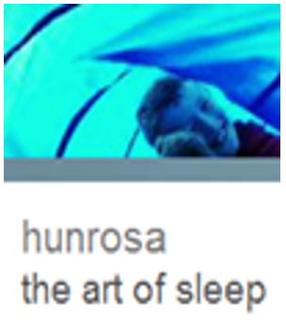
Helping a child to
Sleep Wise
@HunrosaSleep
www.hunrosa.co.uk

Slide 2
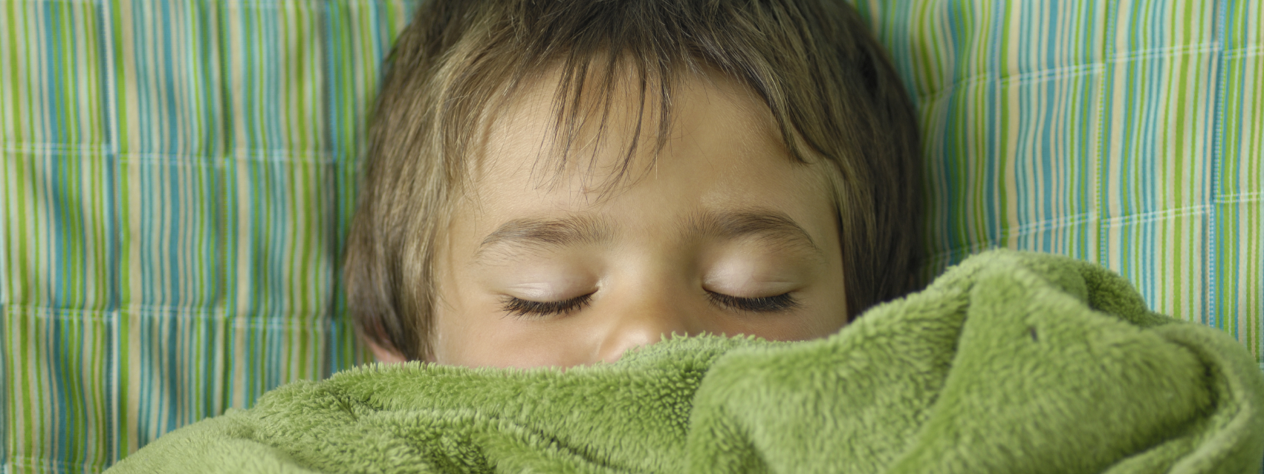
After the sleep programme was completed, 99.9% reported improvements in child’s sleep
88% of families who received a sleep programme followed it through to conclusion
Professional training is CPD accredited
Parents & professionals were highly satisfied with workshop sessions
Biggest changes: quality of life for families and the disabled child’s daytime behaviour
77% improved their natural melatonin production: they didn’t need prescribed melatonin/reduced.
80% stopped prescribed melatonin completely.
Demand for assessments was high: the annual contract for 50 assessments fulfilled in 6 months
Is sleeplessness an NHS issue for children and young people?

Slide 3
Impact of sleeplessness
Why do we need to sleep?
Sleep deprived workers in the UK have worse health and poor productivity. It is estimated that it costs the UK economy £40 billion a year.
Up to one-quarter of all accidents on major roads are due to lack of sleep.
In the US, doctors on shifts made 36% more serious medical errors and are five times more serious misdiagnoses.
Lack of sleep is now linked to developing Alzheimer’s and Parkinson’s diseases. It increases the risk of Type 2 diabetes, heart disease and cancer. It makes us more likely to be obese.
In disabled children sleep deprivation can make health conditions worse and even mirror certain disabilities.

Slide 4
Sleep science
Body clock and tiredness
The light enters the eye, travelling behind the layer of rods and cones to light sensitive cells. These cells send a message to the area of the hypothalamus, specifically the suprachiasmatic nucleus (this is in the centre of the brain, central to our bodily functions including fight, flight or freeze).
Light also affects hormones, body temperature and vigilance.
The body clock regulates how tired we feel during the day.
There are lots of other smaller clocks in our body, affected by light. Every cell has this clock capability.
Voigt R et al (2013). Illustration in the public domain.
Modern artificial light is shifting our body clocks.

Slide 5
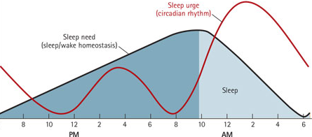
Circadian rhythm and homeostatic sleep drive
What makes us sleep??
Sleep urge (circadian rhythm)
Melatonin at its peak
Sleep need
(sleep/wake homeostasis)
Sleepiness
Time

Slide 6
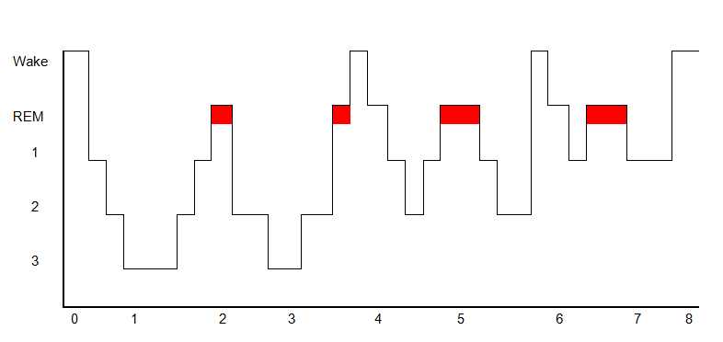
Sleep science: The Hypnogram
Stages of sleep
Time (hours)
REM sleep
This is dream sleep, busy brain, consolidating memories, processing emotions, relieving stress, learning
Stage 3 sleep
This deep sleep, important for physical development, tissue repair, hormone production, growth

Slide 7
Sleep disorders and parasomnias
The most common sleep disorders include:
Restless legs syndrome (RLS): An irresistible urge to move legs.
Delayed sleep phase syndrome (DSPS): inability to awaken and fall asleep at socially acceptable times
Narcolepsy: Excessive daytime sleepiness, often culminating in falling asleep spontaneously and unwillingly at inappropriate times. Cataplexy, a sudden weakness in the motor muscles that could result in collapse to the floor.
Obstructive sleep apnoea: Obstruction of the airway during sleep, causing lack of sufficient deep sleep; often accompanied by snoring.
Some frequent parasomnia are:
Night terrors: Abrupt awakening from sleep with behaviour consistent with terror.
Sleepwalking: Engaging in activities that are normally associated with wakefulness (such as eating or dressing), which may include walking, no conscious knowledge.
Periodic limb movement disorder (PLMD): Sudden involuntary movement of arms and/or legs during sleep, for example kicking the legs.
Rapid eye movement behaviour disorder (RBD): Acting out violent or dramatic dreams while in REM sleep.

Slide 8
Where you can sleep
Make sure that the bedroom is quiet and dark. Keep the room a restful and peaceful haven. Black-out blinds will make the room darker if necessary.
Is the bed comfortable? When did you last change the mattress and pillows? Is the bed too small?
No TVs or iPads or phones. From at least 1 hour before bedtime and keep the devices out of the bedroom. The blue light emitted from electronics suppresses the production of melatonin, the hormone that helps us sleep.
Keep room temperature between 16—18ºC. High temperatures disturb sleep. Is the bed linen/duvet too much or too little?
Have water beside the bed to drink if needs be in the night.
Get a good dose of daylight first thing. In the winter months you could use a Lumie clock (or similar). A simple alarm clock can be used to prevent early risers from getting out of bed.

Slide 9
In the time before sleep … zzzz
If possible keep regular bedtimes. Regular exercise and meals, but not too close to bedtime.
Do not put pyjamas on too early, this gives the brain confusing messages.
Have a warm bath before bed.
A light snack 30-minutes before bedtime (eg a bowl of cereal, fruit, yoghurt) can help prevent disruption from night-time hunger, but avoid evening ‘grazing’.
Minimise use of caffeine, particularly in the evening period. Especially avoid cola, chocolate, tea and coffee at this time. Fruit juices and squash can cause night-time urgency.
Minimise electronics use for the 60 minutes before bedtime.
Consider relaxation strategies to ‘wind down’.

Slide 10
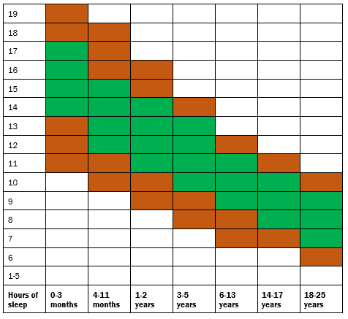
Average sleep needs
May be appropriate
Recommended
Source: National Sleep Foundation

Slide 11
What can affect children
Day/night perception – Are there clear boundaries and differentiations? It is consistent?
Ways to do this include:
lively play should become quiet play before bedtime
the same sequence of events should happen every night – social stories can help.
use cues to signal bedtime environmental and behavioural (eg clock, closing curtains).
are they over-alerted and cannot switch off/under-alerted and cannot settle – do they need help with this
bath time helps melatonin production and a bedtime promotes relaxation
recorded stories or music, etc, can be used -- but must be switched off just before sleep
wake the child at a regular hour each morning.

Slide 12
Other things that affect sleep
Pain: The FLACC pain scale can be used for children with communication problems.
Exercise: Are they getting too much or too little?
Continence.
Medication: Its action may prevent sleep.
Medical conditions: Sleep apnoea, epilepsy, restless legs, etc.
Anxiety.
Sensory overload.

Slide 13
Ideas for soothing anxiety
Worry dolls, boxes/bags of worries, fairy doors, bubbles.
Talking and drawing – what’s worrying them – get them to test it out.
Transitional object such as a family picture or soft toy.
Enough light – use a calming nightlight (but not a blue light).
Stress balls, such as Mohdoh .
Massage, aromatherapy .
For bedwetting see the ERIC website.
Mindfulness/meditation
Read stories -- see the Moshi Twilight app. Books can also be used (eg The Huge Bag of Worries by Virginia Ironside).
Enough sleepiness – it counters arousal due to anxiety.

Slide 14
Detecting sleep problems
Is daytime tiredness constantly an issue? Complete a sleep diary to get a picture of what is going on.
Check food and exercise, keep in mind what you do in the day will affect sleep.
Increase melatonin production by using a calming routine
Emphasise the difference between day and night
Use these slides to inform parents, especially average sleep needs.
Techniques: gradual retreat, rapid return, extinction – Cerebra produce information cards & have a helpline for some disabilities
Contact Hunrosa for some free advice www.hunrosa.co.uk. Phone 01579 346070 email info@hunrosa.co.uk @HunrosaSleep
Get sleep added to the child’s plan or EHCP

